Slide 1

Computer Based Engineering Mathematics Lab Summer Semester 2019
Project 2: Regression Analysis
Project Coordinators Universität Duisburg-Essen Prof. Dr. Johannes Gottschling Dr. Robert Martin Saad Alvi, M.Sc. | Group Members (Group 21) Aleksandar Ivanov -------3072306 Md Shamsul Haque------3070938 Md Aminul Islam------3070939 A K M Rezaul Hoque-----3077415

Slide 2
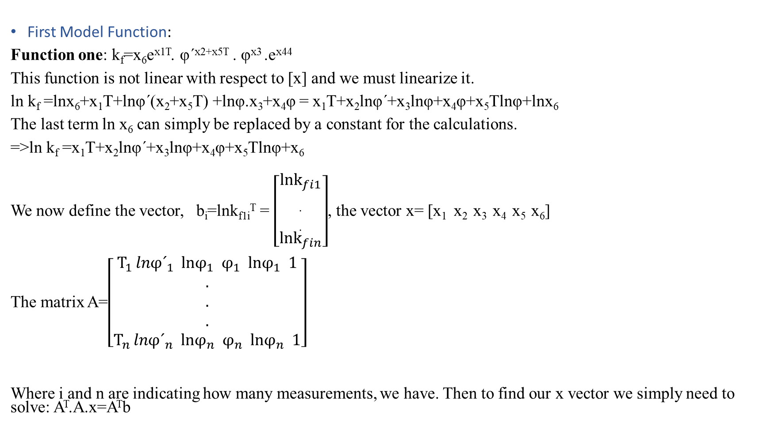
Description
First Model Function:
Function one: k_{f}=x₆e^{x1T}. φ´^{x2+x5T} . φ^{x3} .e^{x44}
This function is not linear with respect to [x] and we must linearize it.
ln k_{f} =lnx₆+x₁T+lnφ´(x₂+x₅T) +lnφ.x₃+x₄φ = x₁T+x₂lnφ´+x₃lnφ+x₄φ+x₅Tlnφ+lnx₆
The last term ln x₆ can simply be replaced by a constant for the calculations.
=>ln k_{f} =x₁T+x₂lnφ´+x₃lnφ+x₄φ+x₅Tlnφ+x₆
We now define the vector, b_{i}=lnk_{f1i}^{T} = $\left[\begin{aligned}lnk_{fi1} \\ . \\ . \\ lnk_{fin}\end{aligned}\right]$, the vector x= [x₁ x₂ x₃ x₄ x₅ x₆]
The matrix A=$\left[\begin{aligned}T_{1} {lnφ´}_{1} lnφ_{1} φ_{1} lnφ_{1} 1 \\ . \\ . \\ . \\ T_{n} {lnφ´}_{n} lnφ_{n} φ_{n} lnφ_{n} 1\end{aligned}\right]$
Where i and n are indicating how many measurements, we have. Then to find our x vector we simply need to solve: A^{T}.A.x=A^{T}b

Slide 3
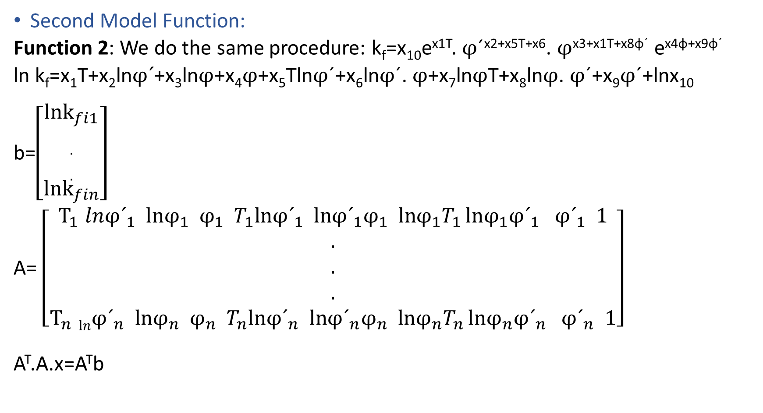
Second Model Function:
Function 2: We do the same procedure: k_{f}=x₁₀e^{x1T}. $φ$´^{x2+x5T+x6}. $φ$^{x3+x1T+x8φ´} e^{x4φ+x9φ´}
ln k_{f}=x₁T+x₂ln$φ´$+x₃ln$φ$+x₄$φ$+x₅Tln$φ$´+x₆ln$φ$´. $φ$+x₇ln$φ$T+x₈ln$φ$. $φ$´+x₉$φ$´+lnx₁₀
b=$\left[\begin{aligned}lnk_{fi1} \\ . \\ . \\ lnk_{fin}\end{aligned}\right]$
A= $\left[\begin{aligned}T_{1} {lnφ´}_{1} lnφ_{1} φ_{1} T_{1}ln{φ´}_{1} ln{φ´}_{1}φ_{1} lnφ_{1}T_{1 }lnφ_{1}{φ´}_{1} {φ´}_{1} 1 \\ . \\ . \\ . \\ T_{n} ln{φ´}_{n} lnφ_{n} φ_{n} T_{n}ln{φ´}_{n} ln{φ´}_{n}φ_{n} lnφ_{n}T_{n }lnφ_{n}{φ´}_{n} {φ´}_{n} 1\end{aligned}\right]$
A^{T}.A.x=A^{T}b

Slide 4
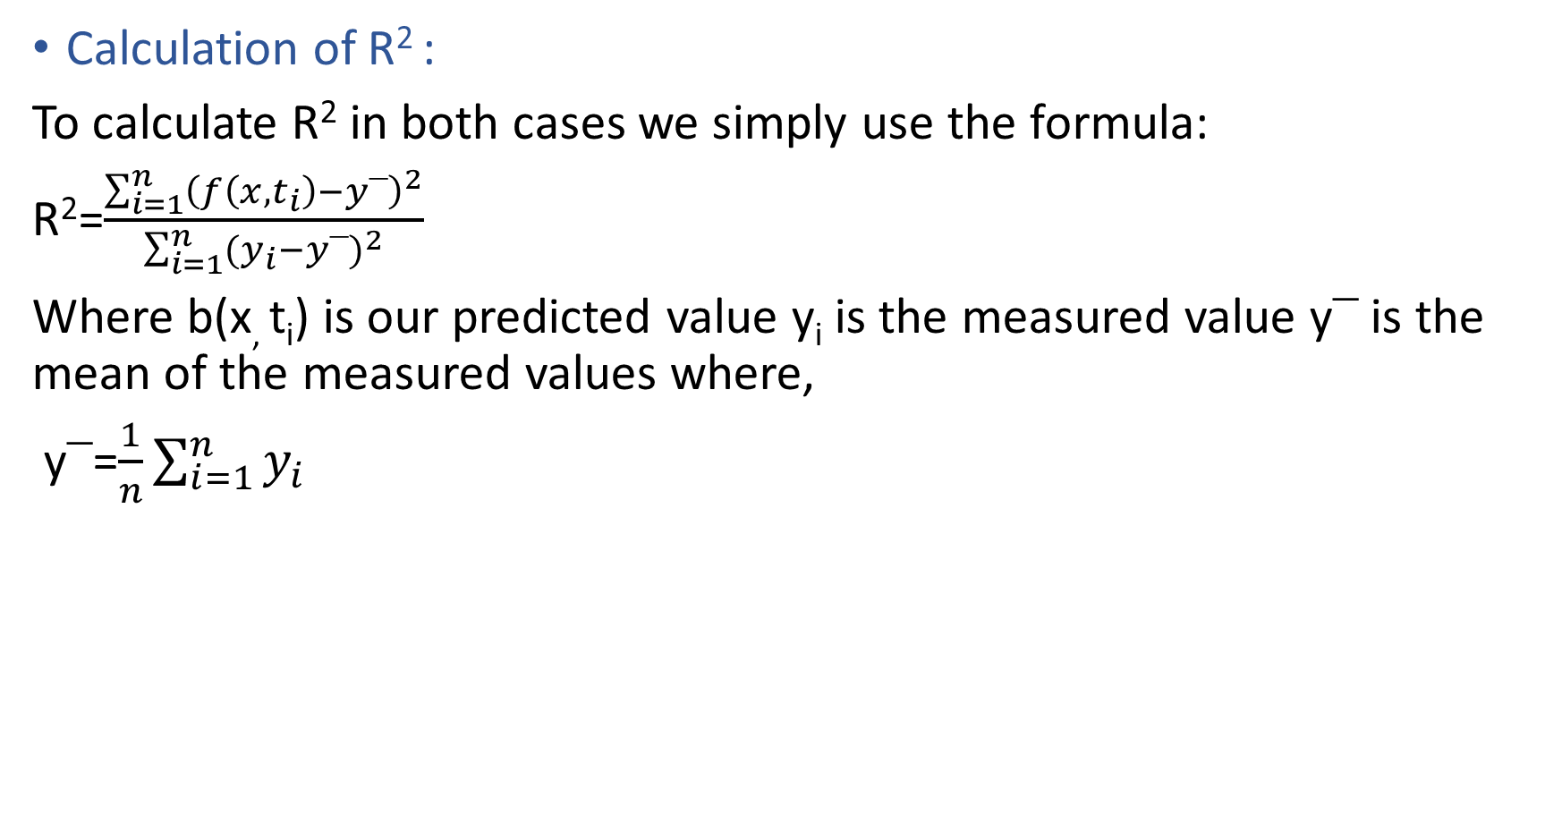
Calculation of R² :
To calculate R² in both cases we simply use the formula:
R²=$\frac{\sum_{i=1}^{n}{{\left(f\left(x,t_{i}\right)−y⎺\right)}^{2}}}{\sum_{i=1}^{n}{{(y_{i}−y⎺)}^{2}}}$
Where b(x, t_{i}) is our predicted value y_{i} is the measured value y$⎺$ is the mean of the measured values where,
y$⎺$=$\frac{1}{n}\sum_{i=1}^{n}{y_{i}}$

Slide 5
Getting our vectors of the parameters and R² : For the first model
x06=6x1 -0.0013 0.0623 0.1520 -0.1681 -0.0001 7.1509 R²_06 = 0.6145 | x15=6x1 -0.0009 0.0520 0.0987 -0.0476 -0.0001 6.6426 R²_15 = 0.4425 | x60=6x1 -0.0021 0.0114 0.2918 -0.6639 0.0001 7.7565 R²_60 = 0.8981

Slide 6
For the Second model
z06=10x1 -0.0016 0.0820 0.2586 -0.0297 -0.0001 -0.0521 -0.0003 0.0008 0.0010 7.2278 R²_06 = 0.6255 | z15=10x1 -0.0015 0.0679 0.3055 0.0651 -0.0001 -0.0119 -0.0004 0.0005 -0.0003 6.8724 R²_15 = 0.4754 | z60=10x1 -0.0022 -0.0457 0.3557 -0.5538 0.0001 0.0085 -0.0002 -0.0000 0.0036 7.6979 R²_60 = 0.9082

Slide 7
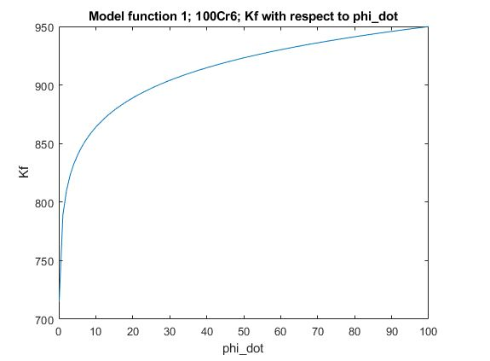
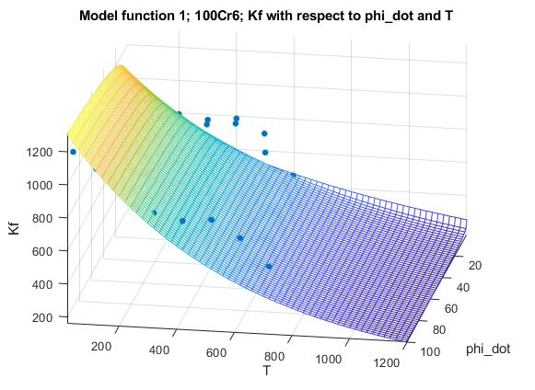
Best fitting curve for 100Cr6 using model function 1: y=1275.255681*e^(-0.001285*T)*phi_dot^(0.062255+-0.000105T)*phi^0.152007*e^(-0.168144phi)

Slide 8
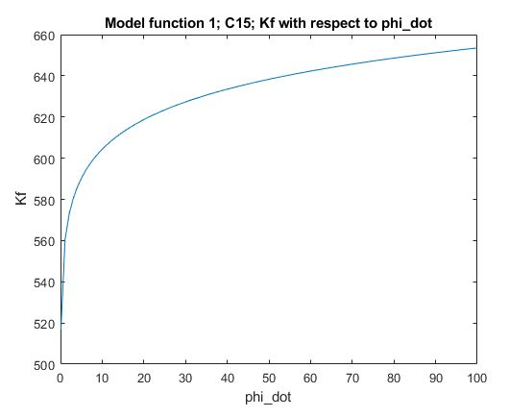
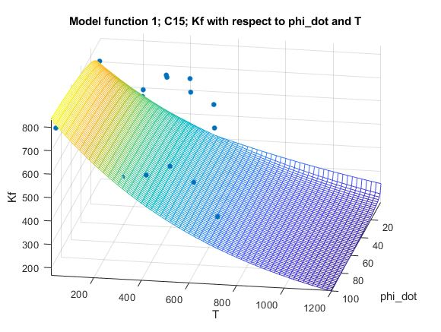
Best fitting curve for C15 using model function 1: y=767.098096*e^(-0.000945*T)*phi_dot^(0.052005+-0.000090T)*phi^0.098706*e^(-0.047643phi)

Slide 9
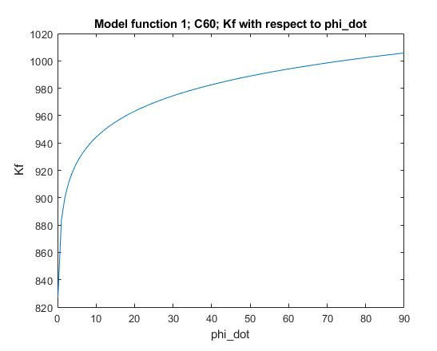
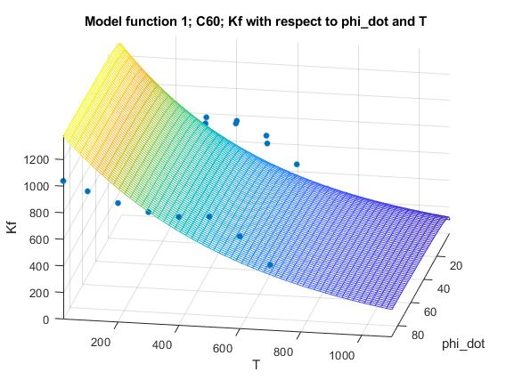
Best fitting curve for C60 using model function 1: y=2336.604239*e^(-0.002137*T)*phi_dot^(0.011358+0.000087T)*phi^0.291779*e^(-0.663931phi)

Slide 10
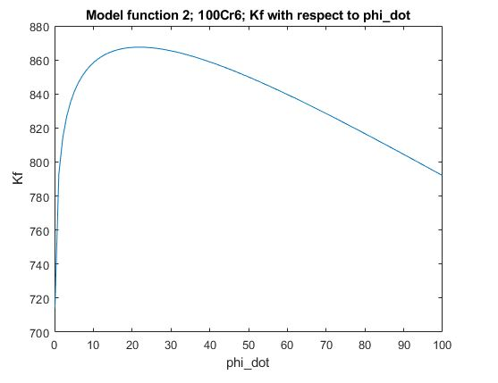
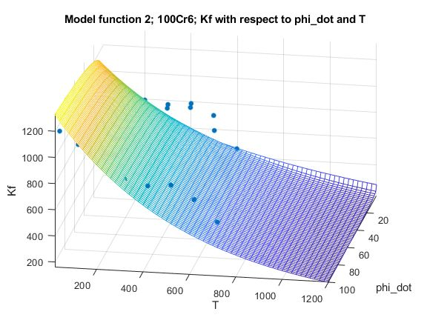
Best fitting curve for 100Cr6 using model function 2: y=1377.226561*e^(-0.001593*T)*phi_dot^(0.082002+-0.000105T+-0.052111phi)*phi^(0.258644+-0.000258T+0.000830phi_dot)*e^(-0.029658phi+0.000957phi_dot)

Slide 11
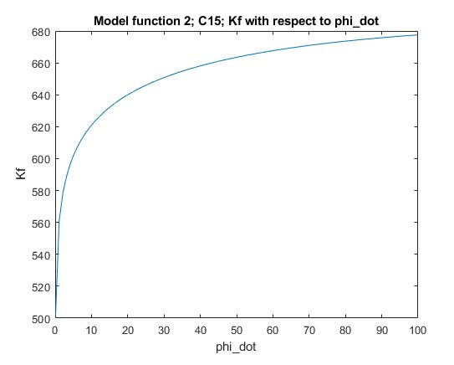
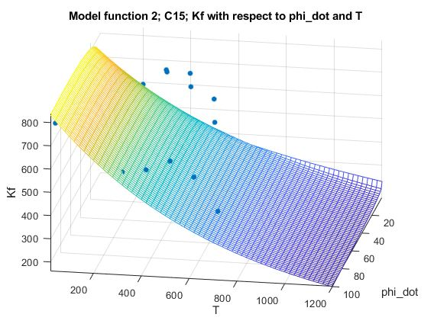
Best fitting curve for C15 using model function 2: y=965.231734*e^(-0.001481*T)*phi_dot^(0.067929+-0.000086T+-0.011947phi)*phi^(0.305504+-0.000428T+0.000504phi_dot)*e^(0.065144phi+-0.000311phi_dot)

Slide 12
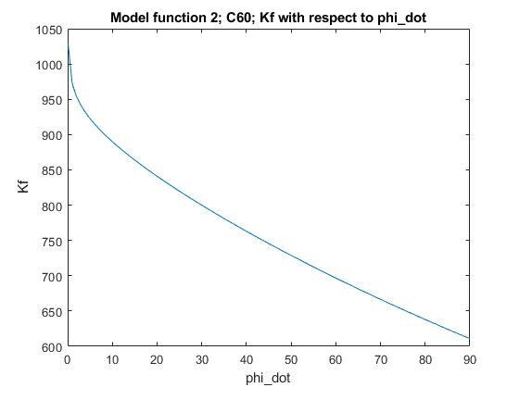
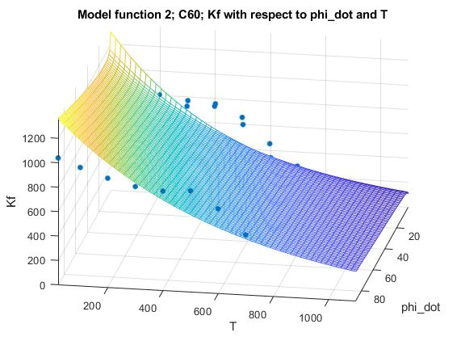
Best fitting curve for C60 using model function 2: y=2203.671363*e^(-0.002240*T)*phi_dot^(-0.045741+0.000101T+0.008467phi)*phi^(0.355744+-0.000174T+-0.000021phi_dot)*e^(-0.553828phi+0.003597phi_dot)

Slide 13
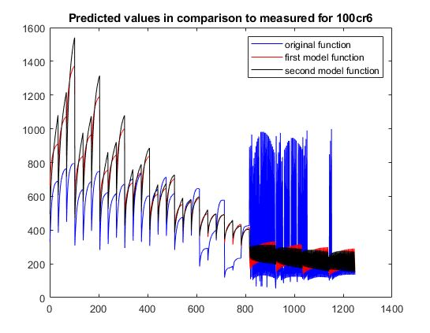
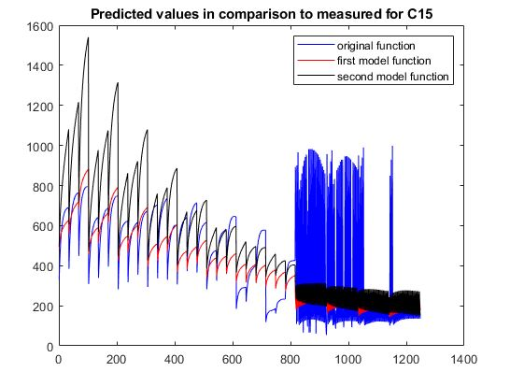
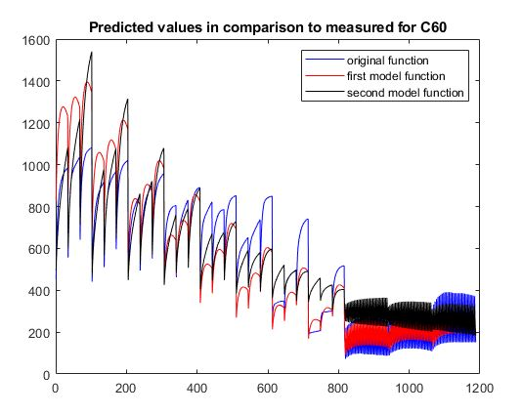
Predicted Values Vs Measured Ones For Data Sheet

Slide 14
Comparison Between Two Models
We know from the script that the R² measured always between 0 and 1, i.e. : 0<= R² <=1. The closer R² is to one, the better the approximation of the measured data by the calculated fitting curve.
We have already seen that the model 2 has a better R² but model one still fits some parts of the curve better.

Slide 15
Matlab Codes For Model Functions
%Model Function 1 function x = func1(C1) A=[C1(:,4) C1(:,1) C1(:,2) C1(:,3) C1(:,1).*C1(:,4) ones(size(C1(:,1)))]; b=C1(:,5); x=A\b; end | %Model Function 2 function z = func2(mdata) A=[mdata(:,5) mdata(:,1) mdata(:,3) mdata(:,4) mdata(:,1).*mdata(:,5) mdata(:,1).*mdata(:,4) mdata(:,5).*mdata(:,3) mdata(:,2).*mdata(:,3) mdata(:,2) ones(size(mdata(:,1)))]; b=mdata(:,6); z=A\b; end

Slide 16
Matlab Codes For R²
%Model Function 1 function R_2 = R_square_1(in,x) f=[in(:,4) in(:,1) in(:,2) in(:,3) in(:,1).*in(:,4) ones(size(in(:,1)))]; y=f*x; y_av=mean(in(:,5)); sf=sum((y-y_av).^2); mf=sum((in(:,5)-y_av).^2); R_2=sf/mf; end | %Model Function 2 function R2 = R_square_2(mdata,z) f=[mdata(:,5) mdata(:,1) mdata(:,3) mdata(:,4) mdata(:,1).*mdata(:,5) mdata(:,1).*mdata(:,4) mdata(:,5).*mdata(:,3) mdata(:,2).*mdata(:,3) mdata(:,2) ones(size(mdata(:,1)))]; y=f*z; y_av=mean(mdata(:,6)); sf=sum((y-y_av).^2); mf=sum((mdata(:,6)-y_av).^2); R2=sf/mf; end

